Slide 1
Group 9 Wilson Financial
Members:
Amanda Riley
Jaci Brown
Hlee Xiong Gabriel Sanchez-Jorgensen

Slide 2
Case study summary:
We agreed to work on Wilson Financial, which involved a small financial advisement firm in rural New Mexico. The owners, Ned and Jake Wilson, had many things they wanted to review to ensure they were maintaining a profitable business and optimal customer service.

Slide 3
Rules and assumptions
Business Rules (Clients, Accounts, Transactions)
A client may have multiple accounts.
A client can be associated with multiple transactions.
Each account is exclusively owned by a single client.
An account may have multiple transactions, but a transaction will belong to only one account.
Assumptions
All table values were assumed for our example database purposes, including account types, and names. In order to calculate clients added in the last 6 months, we also assumed this meant specifically between September 1st, 2023 and March 1st, 2024. Additionally, we assumed no responsibility for actual transactions, only analysis of their records.
\

Slide 4
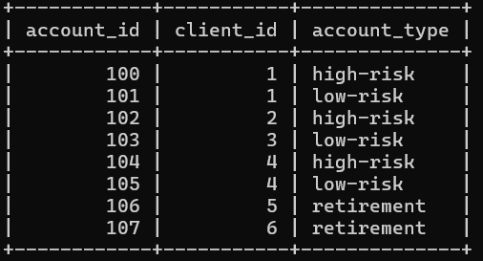
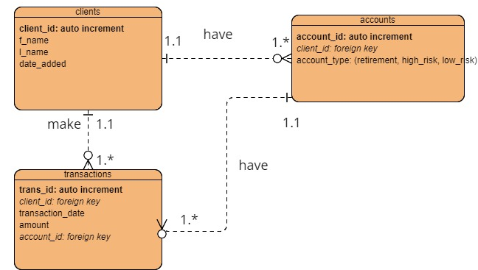
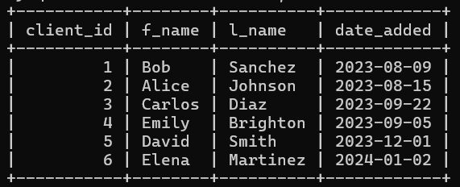
ERD & Database setup

Slide 5
Reports and solutions
The Wilson brothers had many questions they wanted to consider about the business. We were able to answer several for them.

Slide 6

Question/Report 1:
How many clients have been added for each of the past six months? We derived the month that each client was added based on the full date they were added. Then, we limited our query to the last six months and showed which clients were added in each month. Two clients were added in September, and one was added each in December and January. This could help the business decide if they are getting enough new clients regularly.

Slide 7

Question/Report 2
What is the average amount of assets (in currency) for the entire client list?
To display this, we summed up all of the positive and negative transactions (deposits and withdrawals) for each client in order to get total assets, and used the SQL average function to determine the average. This report gives the business a picture of how many assets they are managing, and in particular how much wealth each of their individual clients is investing with them.

Slide 8

Question/Report 3
How many clients have a high number (more than 10 a month) of transactions? For this report, we collected the number of transactions for each client in each given month, and then displayed a row for each month when a given client had more than 10. This occurred three times with David Smith (which would him more of a habitual high-transaction client), and once with Elena Martinez. The business might decide based on transaction frequency to implement or do away with transaction-based fees.

Slide 9

Thank you
Group 9
CSD 310 Case Study Presentation
Jaci Brown
Amanda Riley
Gabriel Sanchez-Jorgensen
Hlee Xiong

